Slide 1
DEF/LEF to SVG
Ahmed Sharaf-ElDein
Ahmed Marzouk

Slide 2
Problem
- Convert a routed design in DEF and LEF to a layout in SVG

Slide 3
Solution
- Parsing the DEF and LEF files.
- Iterate through the DEF and, using SVG library, draw:
* Every cell given the dimensions stated in the LEF file.
* The pins.
* The nets.

Slide 4
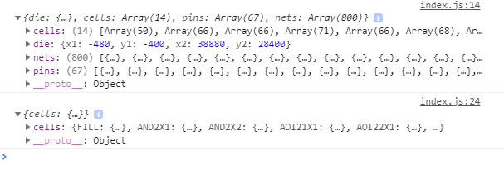
Parsing the DEF and LEF files.

Slide 5
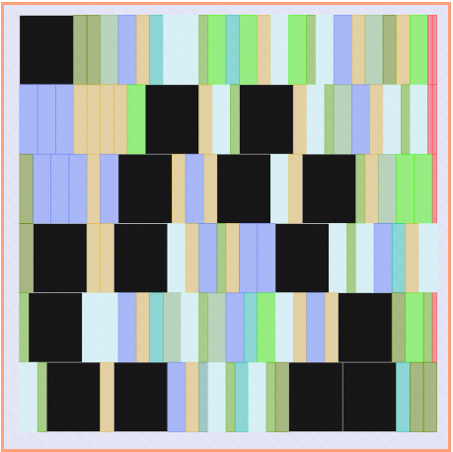
Drawing the cells

Slide 6
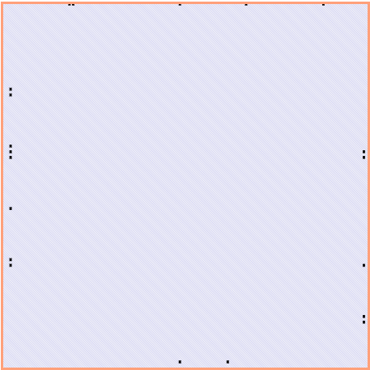
Drawing the pins

Slide 7
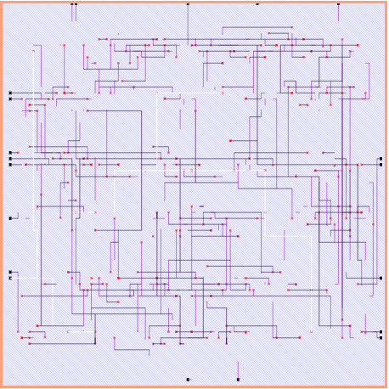
Drawing the Nets

Slide 8
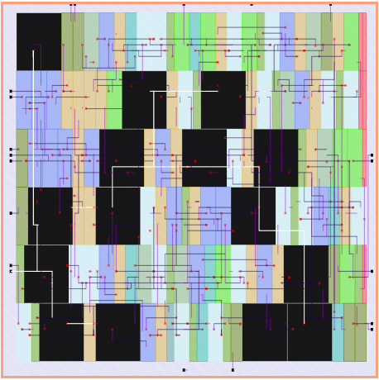
All Together

Slide 9
DEMO

Slide 10
THANK YOU

